Slide 1
The War on Terrorism and Modern America
By Mrs. Zimmerman
Fall 2013

Slide 2
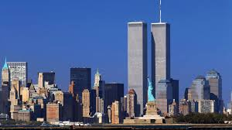
What do you think the World Trade Center symbolizes?
“They were never meant to be merely buildings.”

Slide 3
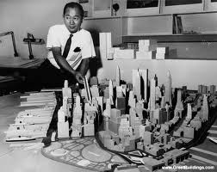
Minoru Yamasaki, Chief Architect of WTC
“The World Trade Center is a living symbol of man’s dedication to world peace.”
Ironically, Mr. Yamasaki made the following comment about the WTC when it was first built.

Slide 4
At first, New Yorkers were critical of the WTC
In 1966 when buildings were demolished to build the WTC what was known, “however, was that all of "Radio Row," a historical business quarter at the southern tip of Manhattan, would have to be completely demolished in order to make space for the center.”
The urban historian Lewis Mumford called the towers "just glass-and-metal filing cabinets.”

Slide 5
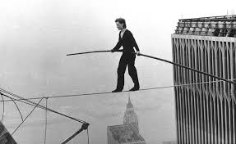
Then New Yorkers came to love the WTC
Philippe Petit (“Man on a Wire” ) below and Liza Minnelli (left)
Just two of the famous people photographed at the WTC.

Slide 6
What happened in 1993 and 2001 at the WTC? Class completes a KWL chart on what they know about Terrorism
Know Want to Know Learning

Slide 7
Student Oral History Project on 9/11
This is one method used by historians to research a subject.
Student forms handed out- students add their own questions.
** The final part of the project will be when each Student becomes an American foreign policy expert and makes a determination about whether or not America’s policies re. terrorism are effective or not?? (the Simulation)

Slide 8
Homework Day 1- due Nov. 25th
Reading: Choices handout pp. 1-8;
Your Oral History of a relative or friend who experienced 9/11; and
Choices worksheets/ handout 6 and 7.

Slide 9
Part I- History & Definition of Terrorism
“Politically motivated violence directed at civilians and carried out by non-state groups.”
www.choices.edu /Responding to Terrorism: Challenges for Democracy p.2
Notes:
Explain the historical examples of Terrorism. Reign of Terror in France after the French Revolution in 1790s. State sponsored terrorism in Soviet Union after WWII.

Slide 10
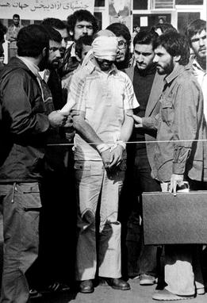
State Sponsored Terrorism
State sponsored terrorism is where a weaker Country in some way aids or abets a terrorist group as a way to strike back at a more powerful country.
The country can fund the terrorist activity, or supply weapons or training or protect the terrorists giving them safe haven in their country.
Iran Hostage Crisis of 1979- where militant students seized 52 U.S. citizens from the of U.S. embassy –was an Iran sponsored act.

Slide 11
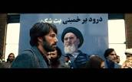
Iran Hostage Crisis of 1979
This State Sponsored terrorism was motivated by their interest in ending U.S. involvement in the Middle East.
2012 Movie “Argo” is about this State Sponsored terrorism.

Slide 12
U.S Responses to State-Sponsored Terrorism
Economic embargoes-refusing to buy or sell goods to countries involved in providing a safe haven or aiding and abetting terrorists.
Military retaliation-including air strikes against targets in the country or drone attacks.
What do you think may be some of the criticisms of military retaliation by the U.S.?

Slide 13
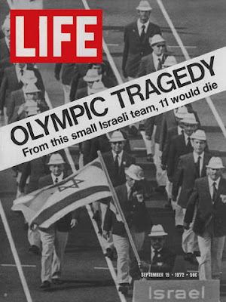
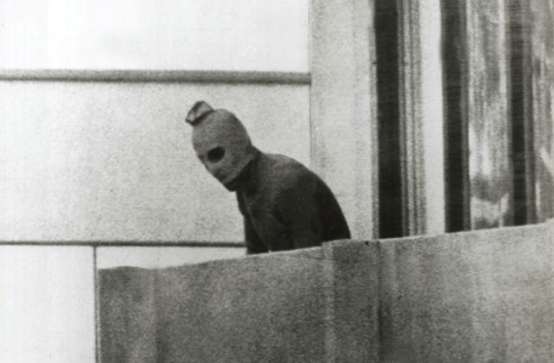
1972 Munich, Germany Olympics Hostage Crisis- 1st example of modern International Terrorism
Target- Olympic Athletes in Olympic Village
Symbol -sports as unity of mankind became marred by this terrorist act& Max. Media Cover.
Who: Terrorist group known as Black September
Motive: They demanded the release of Palestinian prisoners held in Israel for return of the Israeli Olympic athletes who were hostages

Slide 14
International Terrorist watched the Munich Olympics carefully- Learning Lessons from it.
What lessons do you think future terrorists may have taken from this event?
Examples of post-Munich terrorism- aircraft sabotage; hijackings; attacks on diplomats; hostage taking.

Slide 15
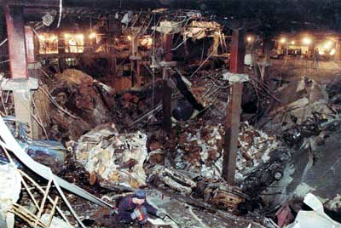
Religiously Motivated Terrorism became a threat in the 1980’s
4 Factors of religious terrorists: 1)Use religion as a justification or “worthy reason” for their terrorist violence;2)Speak about the forces of God against the Devil or good vs. evil in justifying their religiously motivated attacks;3) “the World Gone Wrong” people feeling that they were losing their national identity to foreign value systems-they see religion as a justification for their purposes; 4) No Other Options- people feeling that they and their country is powerless to change things w/o violence.
Examples of Religiously Motivated Terrorism:
Islamist Terrorist group in U.S. carries out 1st World Trade Center bombing in 1993.

Slide 16
Target and Symbol of 1993 WTC Bombing
U.S. target of the 1993 bombing due to its support of Israel; being seen as an enemy of Islam; and its secular culture (non-religious) seen as threat to religion in general and Islam
World Trade Center seen as symbol of U.S. power, technology and NY City as an example of the most well known U.S. city.
What are the differences between the words, target and symbol??

Slide 17
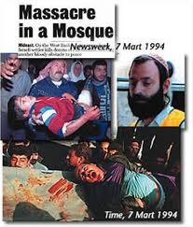
Another Example of Religious Terrorism
Baruch Goldstein- follower of Israeli Jewish terrorist group Kach- kills 29 wounds 150 with automatic rifle aimed at Palestinian Muslim worshippers in the Ibrahim Mosque in Hebron during Islam’s holy month of Ramadan.

Slide 18
Other Religiously Motivated Attacks
Aum Shinrikyo (Japanese Buddhism group) punctures bags of Sarin nerve gas in Tokyo’s subway system.
5,500 injured; 12 died
Group states that their motives are living in dehumanized society with nuclear weapons and threatened Armageddon.
This was one of first terrorist uses of Weapons of Mass Destruction.
Covenant of the Sword, and Arm of the Lord (CSA) – a Christian militant group seeking to overthrow Federal gov. of U.S. & follower Richard Snell made plans to bomb the Alfred Murrah Fed. Building in Oklahoma City and killed a pawn shop owner and bombed a gas pipeline in 1983 and 1984.
Timothy McVeigh, with ties to Christian Identity kills 168, wounds 800 people in bombing of Murrah Fed. Building in 1985. What were the targets and symbols in those examples??
These groups were anti-government and pro-gun.

Slide 19
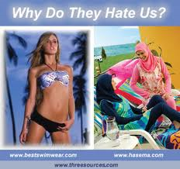
Increased U.S. Concern about Terrorism
Due to terrorist acts not aimed at “merely” calling the world’s attention to their acts of violence , but actually killing as many people as possible.
Also heightened concern about use of “weapons of mass destruction” by terrorist groups.

Slide 20
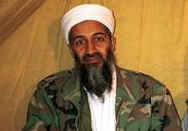
Weighing the threat of terrorism today:
International networks of hundreds of cells of terrorist groups belonging to terrorist groups on different continents.
Potential use of nuclear or biological weapons by terrorist groups.
Osama bin Laden and al Qaeda (terrorist group) responsible for 9/11 attack. Bin Laden killed in May 2011 by U.S. Special Forces. He was a wealthy Saudi Arabian.
Al Qaeda- international terrorist group main goal is to rid Muslim countries of Western influence and replace the gov. in Muslim countries with fundamentalist Islamic regimes.

Slide 21
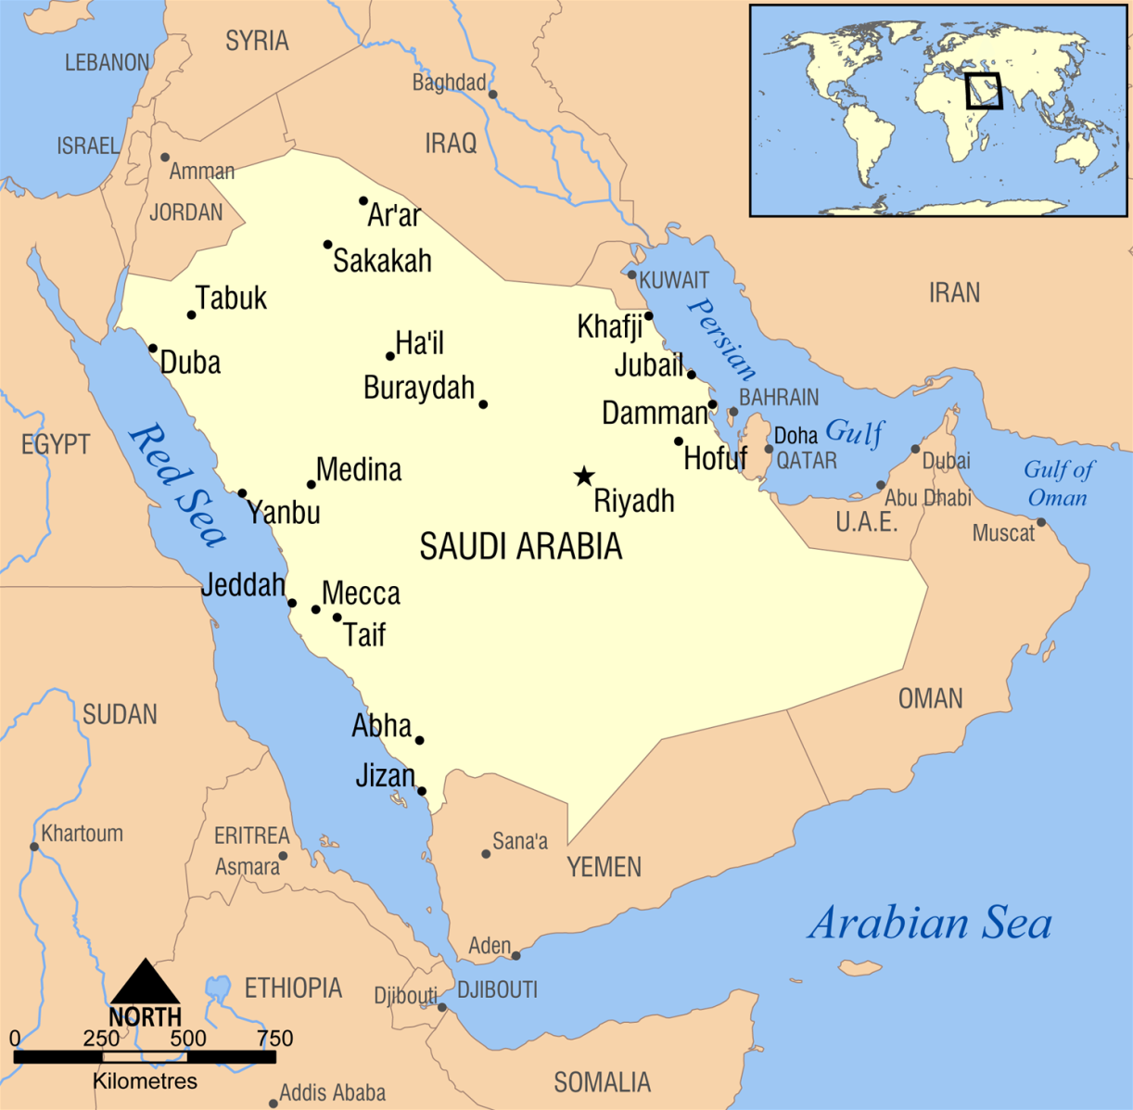
Motives for 9/11 attacks: U.S. presence in holy lands in Middle East, specifically Medina and Mecca. What is the religious significance of those 2 sites?

Slide 22
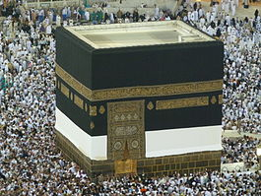
The kabba where every religious Muslim wants to make a pilgrimage or hajj to once in his or her lifetime. A hajj is one of the five pillars of Islam. The kabba is the holiest site in Islam and it is located in Mecca, Saudi Arabia. Also, Muhammad the original prophet of Islam was born in Mecca. We should also remember that every Muslim believes in praying 5 x each day facing Mecca.
Notes:
The Kabba is a granite cubical structure with scripture from the Koran ( the religious book of Muslims) written on all four sides. There is cloth covering the top.
When a Muslim makes his hajj or pilgrimage to the Kabba, he walks around the kabba seven times.

Slide 23
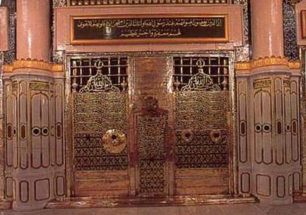
House of Muhammed in Medina. (Holy Site) Medina is the city that Muhammed and his followers fled to after facing persecution in Mecca.

Slide 24
Timeline of U.S. Involvement in Saudi Arabia-Page 1
1980s:
CIA Director William Casey arranges for Saudi Arabia to pay $2 million to prevent the Communists achieving electoral gains in Italy.
The US constructs a series of military communication systems "superbases" in Saudi Arabia. The Saudis foot nearly all the $200 billion bill for these bases.
The US has Saudi Arabia fund and support the mujahedeen fighting the Soviets in Afghanistan. They provide hundreds of millions of dollars each year, probably totaling more than a billion dollars. One of those mujahideen being Saudi national Osama bin Laden. Bin Laden is recruited by the CIA to help lead and raise funds for the mujahideen. The U.S.-supported regimes in Kuwait and Saudi Arabia support Iraq's war effort [against Iran]. Kuwait contributes over $30 billion. The U.S. sell over $20 billion worth of arms to Kuwait, Saudi Arabia and other Gulf states during this period and allow Saudi Arabia to transfer large quantities of U.S. arms to Iraq during the war. 1980: Saudi Arabia takes full control over Aramco.

Slide 25
Timeline of U.S. Presence continued p.2
1990:
5th August – The Iraqi invasion of Kuwait is dramatic to Saudi politics and security. Saudi Arabia allows hundreds of thousands of foreign troops (mainly US) to be stationed on their own soil.
Neither the US nor the Saudis consider it remotely likely that Iraq would invade Saudi Arabia, but US Defense Secretary Cheney flies to Riyadh and tells King Fahd that his country is in danger and needs US forces there to protect it. Saudi Arabia accepts the forces. The US pressures Saudi Arabia and others to support its motions against Iraq in the UN by having them give various perks to wavering nations. September - Bush tells congress that huge numbers of Iraqi troops and tanks are massing in Kuwait to threaten Saudi Arabia. Russian satellite pictures show nothing of the sort.
1993:
USA asks Saudi Arabia to pay for the Gulf War, that cost USA alone US$51 billion. This comes at a time when the Saudi economy is facing severe problems, with budget deficits. [2]
1994:
Islamic dissident Osama Bin Laden is stripped of his Saudi nationality. [1]
2000:
September - The London-based human rights group Amnesty International describes Saudi Arabia's treatment of women, particularly foreign domestic workers, as "untenable" by any legal or moral standard. [1]

Slide 26
2001 Timeline: U.S. & Saudi Relations
11th September - Fifteen of the 19 hijackers involved in attacks on New York and Washington are Saudi nationals. After the attacks and whilst all other flights are grounded, private jets fly wealthy Saudi Arabians, including members of the bin Laden family out of the US. None of them are questioned. [
November - Tony Blair hails Saudi Arabia as "a good friend in the international coalition against terrorism." Still no mention of human rights.
December - King Fahd calls for the eradication of terrorism, saying it is prohibited by Islam; government takes the unprecedented step of issuing identity cards to women.

Slide 27
Al Qaeda’s Greatest Strengths Today
Its ability to inspire other religious groups and individuals.
Today,. As Qaeda is an ideological movement with weakly linked groups and individuals across the world.

Slide 28
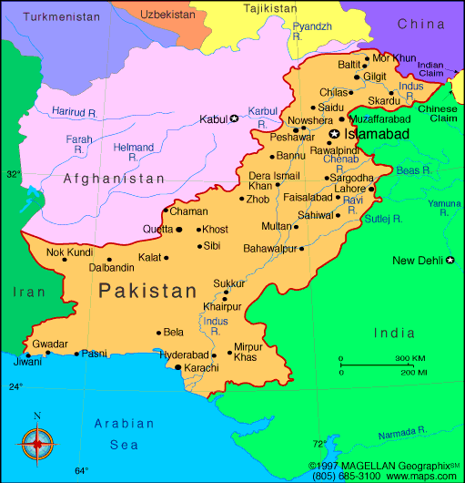
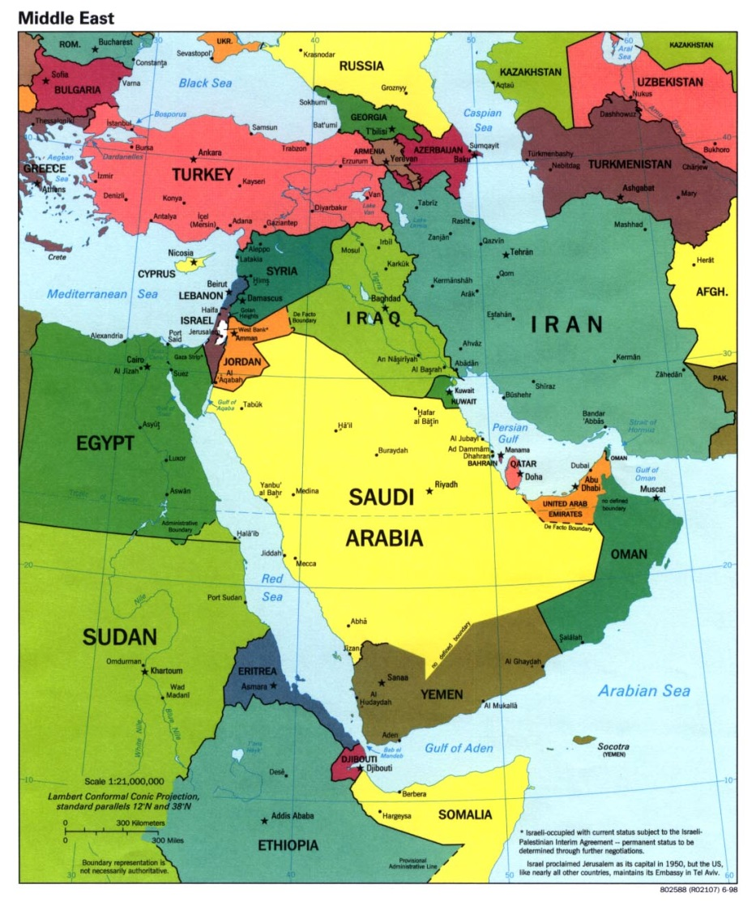
Regions where terrorism poses the greatest threat today
Pakistan
Somalia-See map on rt.
Yemen
Notes:
Pakistan – safe haven for terrorists; training camps for terrorist groups; has nuclear weapopns
Somalia- one of poorest African countries; home of as Shabeeb-militant Islamic terrorist group
With ties to as Qaeda
Yemen- home of al Qaeda of Arabian Peninsula (terrorist group); poorest country in Middle East; dangerous
Unstable.

Slide 29
Threat of a terrorist nuclear attack
The threat is small, however, there is concern in U.S. about terrrorists’ gaining access to nuclear weapons in Russia that were stockpiled during the Cold War or buying them from N. Korea or Pakistan.

Slide 30
Homegrown Terrorism in United States
Homegrown terrorism is when U.S. citizens or residents are inspired by other like minded terrorists. Some work independently and others are connected to international terrorist groups. Some of our homegrown terrorists are trained in terrorist training camps in the Middle East.
2013 April 15: Boston Marathon bombings: Two bombs detonated within seconds of each other near the finish line of the Boston Marathon, killing 3 and injuring more than 180 people.^{[71][72]} Late in the evening of April 18 in Cambridge, Massachusetts an MIT campus police officer was shot and killed while sitting in his squad car. Two suspects then carjacked an SUV and fled to nearby Watertown, Massachusetts, a suburb of Boston. A massive police chase ensued, resulting in a shootout during which several IED's were thrown by the suspects. A Boston transit police officer was critically wounded and suspect Tamerlan Tsarnaev, a Russian immigrant of Chechen ethnicity, was killed. The second suspect, Tsarnaev's younger brother Dzhokhar Tsarnaev, escaped. A "Shelter in place" order was given for Boston, Watertown, and the surrounding areas while house-to-house searches were conducted, but the suspect remained at large. Shortly after the search was called off Tsarnaev was discovered by a local resident hiding inside a boat parked in the resident's driveway less than three blocks from the scene of the shootout. He was taken into custody after another exchange of gunfire and taken to nearby Beth Israel Deaconess Medical Center in Boston, where he was treated for injuries received during his pursuit and capture. Tsarnaev was arraigned on federal terrorism charges from his hospital bed on April 22, 2013.^{[73][74][75][76]} Preliminary questioning indicated the Tsarnaev brothers had no ties to terrorist organizations.^{[77]} A note written by Dzhokhar Tsarnaev on the boat where he was captured said the bombings were retaliation for US actions in Iraq and Afghanistan against Muslims.^{[78}

Slide 31
Homework –Dec. 2, 2013
Finish Reading Handout-Pages 9-16 due Wed. 12/4/2013
**Reminder Quiz on 12/4
Finish analyzing political cartoons: TRB 22-29
Monday, 12/9/2013 reading pp. 17-33 due
Wed. 12/11 Role Play be prepared and Quiz #2

